Slide 1
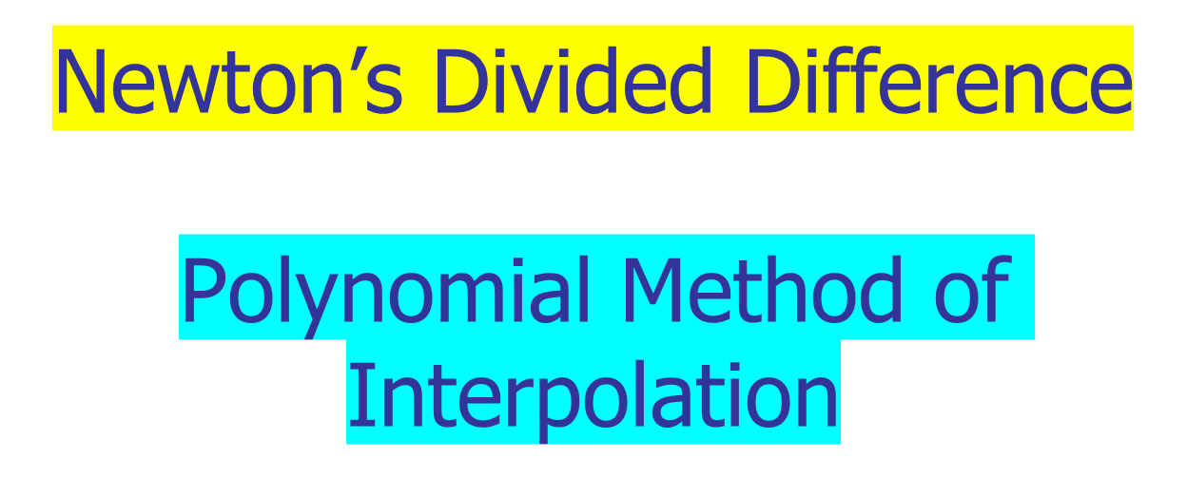
Author: Autar Kaw et. al.
Textbook: TEXTBOOK: NUMERICAL METHODS WITH APPLICATIONS

Slide 2
Newton’s Divided Difference Method of Interpolation

Slide 3
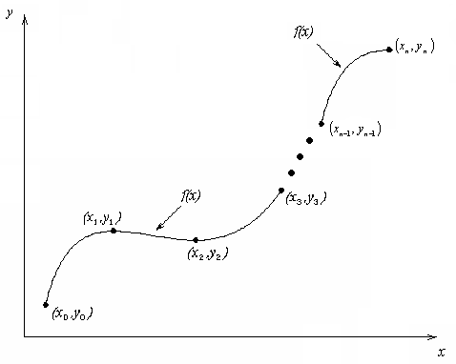
What is Interpolation ?
Given (x₀,y₀), (x₁,y₁), …… ,(x_{n},y_{n}), find the value of ‘y’ at a value of ‘x’ that is not given.

Slide 4

What is Interpolation ?
Given (x₀,y₀), (x₁,y₁), …… ,(x_{n},y_{n}), find the value of ‘y’ at a value of ‘x’ that is not given.
Application: In engineering and science, one often has a function for a limited number of data points. Interpolation is required for finding the function’s value at some intermediate points

Slide 5

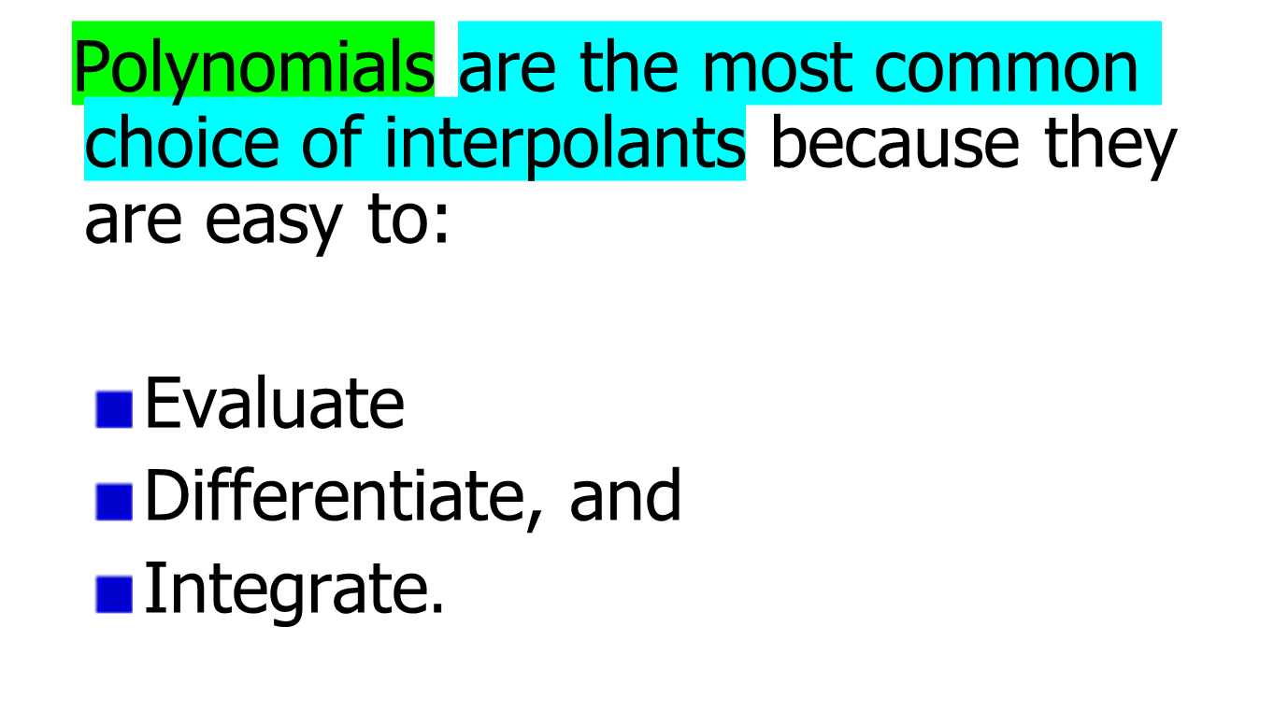

Slide 6







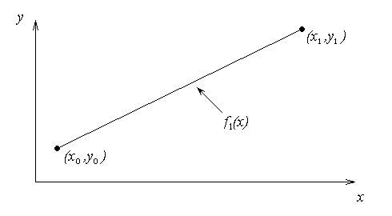


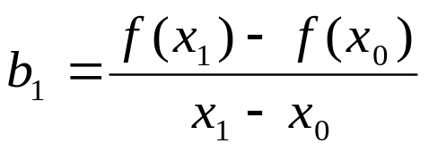


Linear interpolation: Given pass a linear interpolant through the data
where

Slide 7
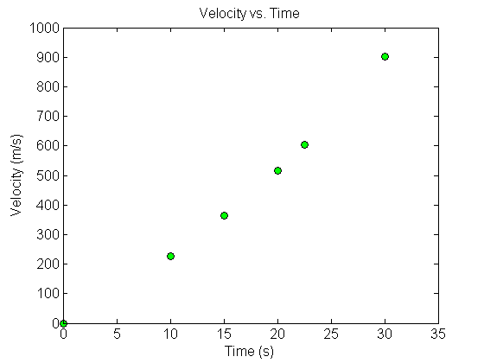



Example
The upward velocity of a rocket is given as a function of time in Table 1. Find the velocity at t=16 seconds using the Newton Divided Difference method for linear interpolation.
Table. Velocity as a
function of time
0 | 0
10 | 227.04
15 | 362.78
20 | 517.35
22.5 | 602.97
30 | 901.67
Figure. Velocity vs. time data
for the rocket example

Slide 8

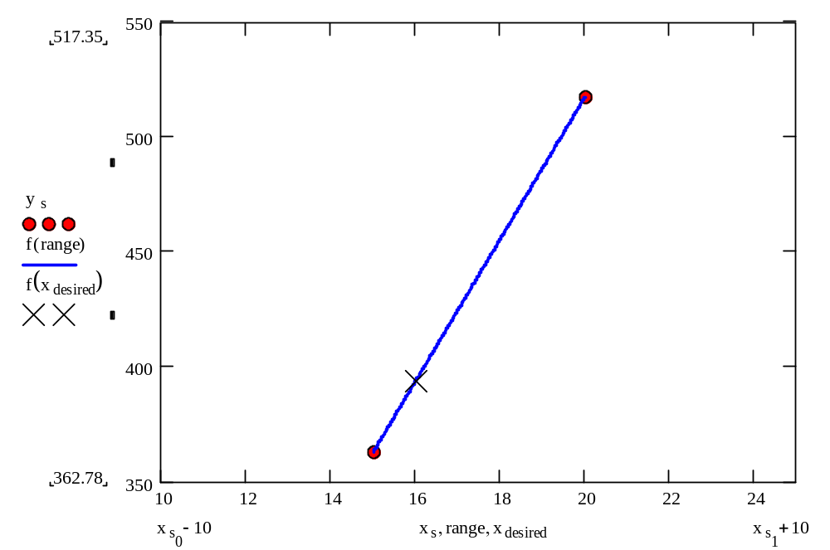
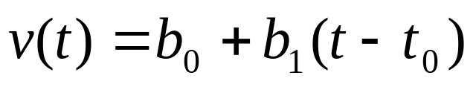
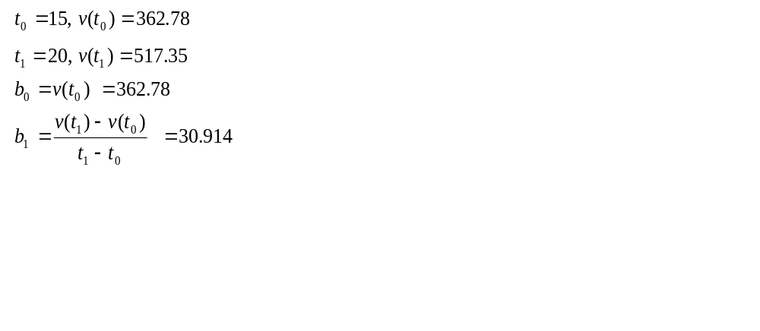







Slide 9
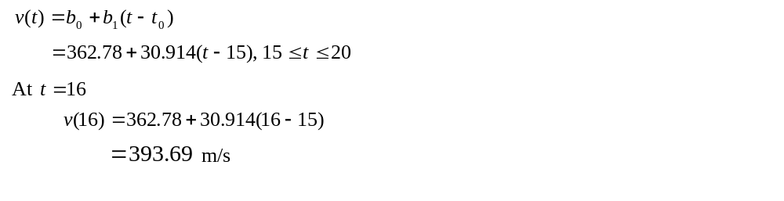

Linear Interpolation (contd)

Slide 10




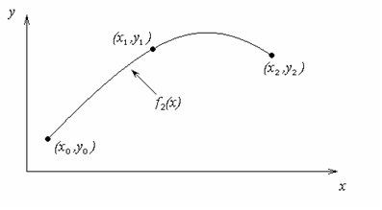

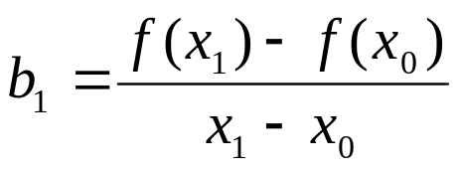


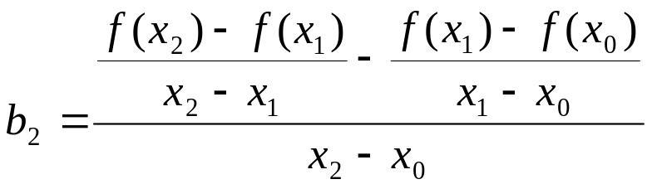



Slide 11




Example
The upward velocity of a rocket is given as a function of time in Table 1. Find the velocity at t=16 seconds using the Newton Divided Difference method for quadratic interpolation.
Table. Velocity as a
function of time
0 | 0
10 | 227.04
15 | 362.78
20 | 517.35
22.5 | 602.97
30 | 901.67
Figure. Velocity vs. time data
for the rocket example

Slide 12
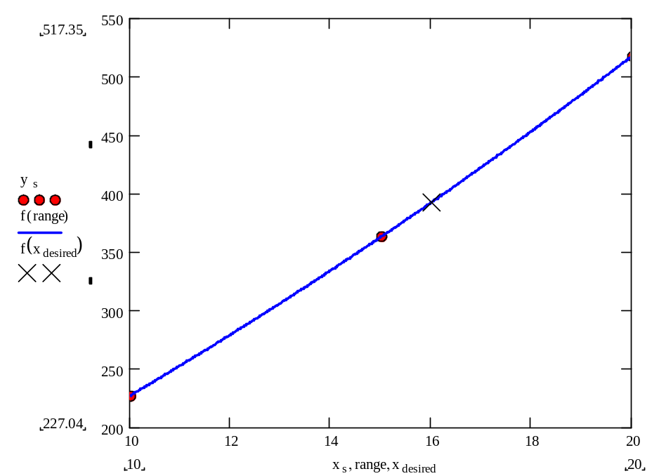

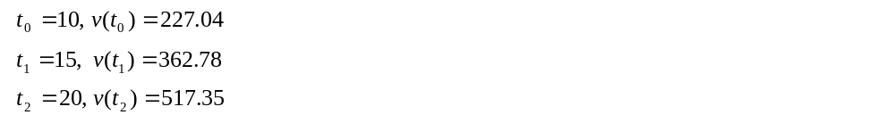




Quadratic Interpolation (contd)

Slide 13
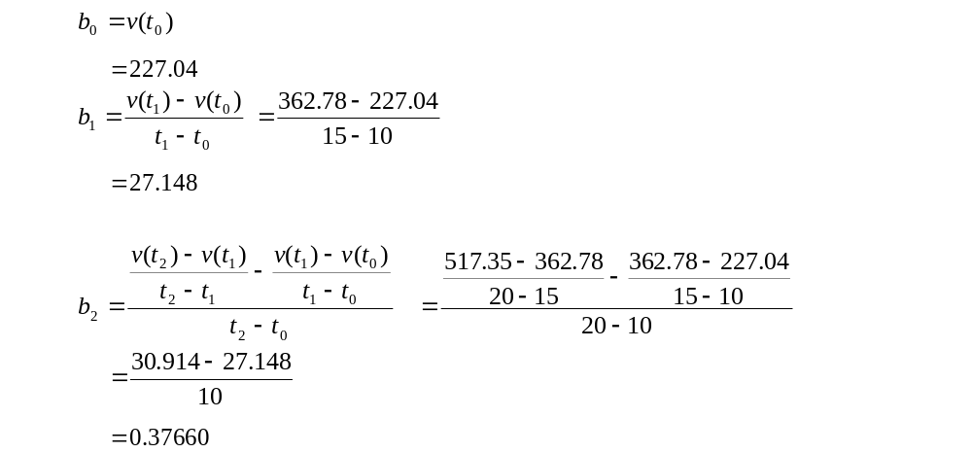





Quadratic Interpolation (contd)

Slide 14
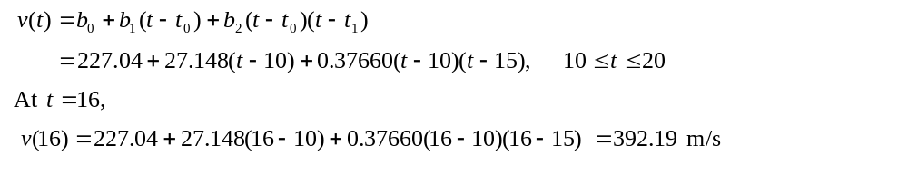
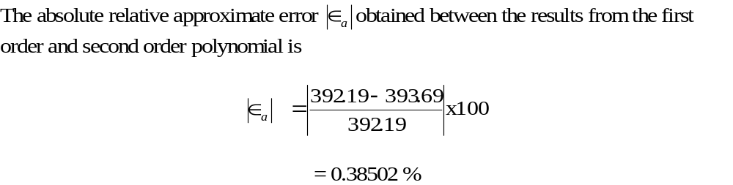
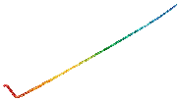
Quadratic Interpolation (contd)

Slide 15





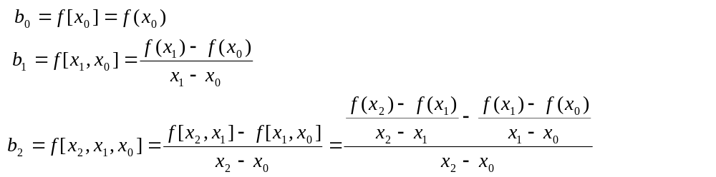








General Form
where
Rewriting

Slide 16
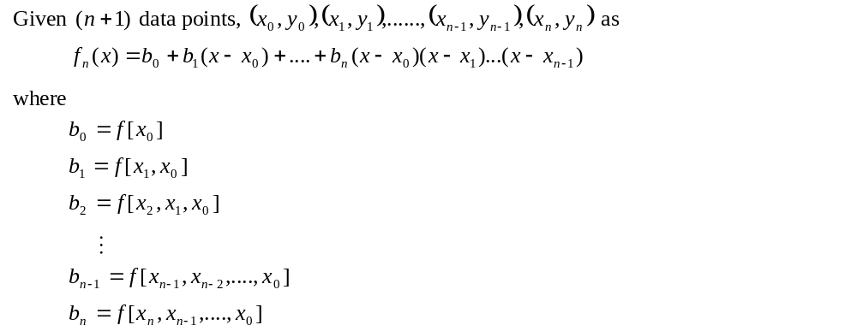



General Form

Slide 17
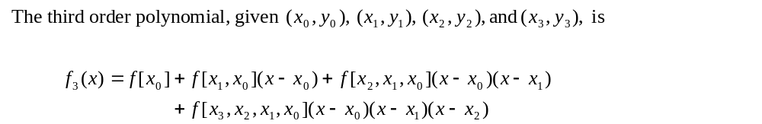
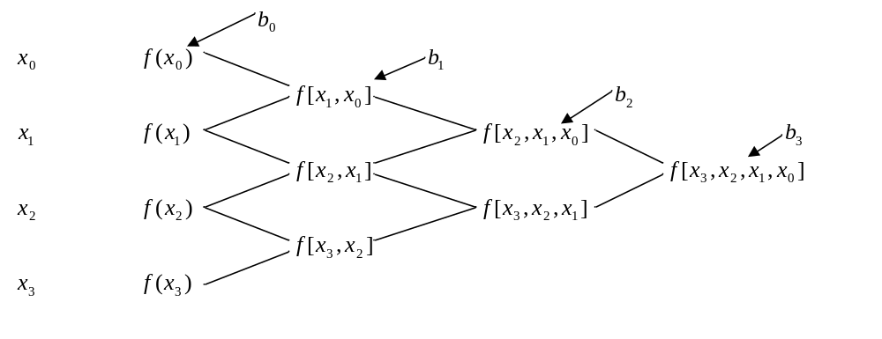
General form

Slide 18


Example
The upward velocity of a rocket is given as a function of time in Table 1. Find the velocity at t=16 seconds using the Newton Divided Difference method for cubic interpolation.
Table. Velocity as a
function of time
0 | 0
10 | 227.04
15 | 362.78
20 | 517.35
22.5 | 602.97
30 | 901.67
Figure. Velocity vs. time data
for the rocket example

Slide 19




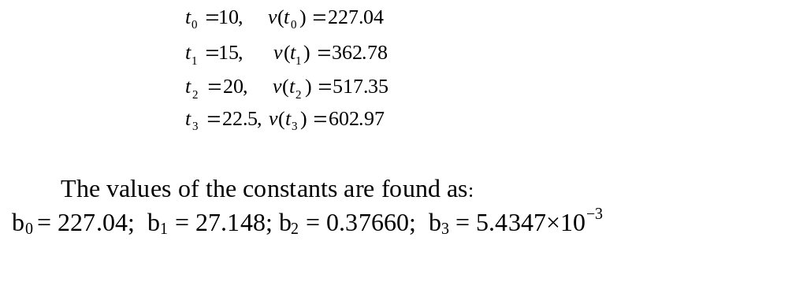
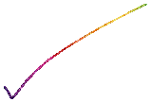
Example
The velocity profile is chosen as
we need to choose four data points that are closest to

Slide 20
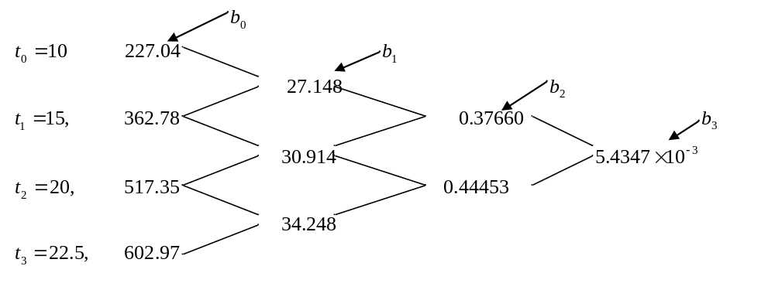
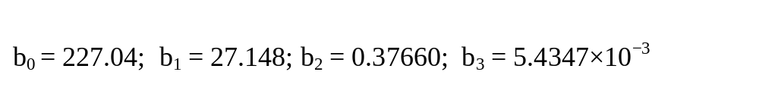
Example

Slide 21
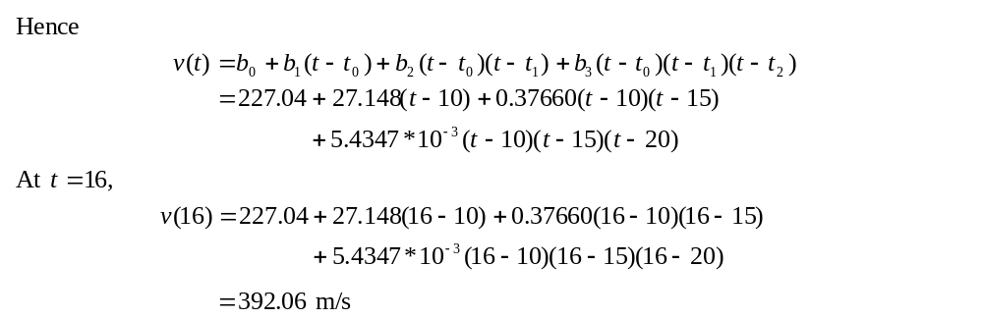

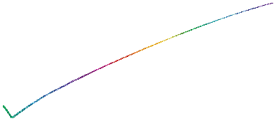
Example

Slide 22
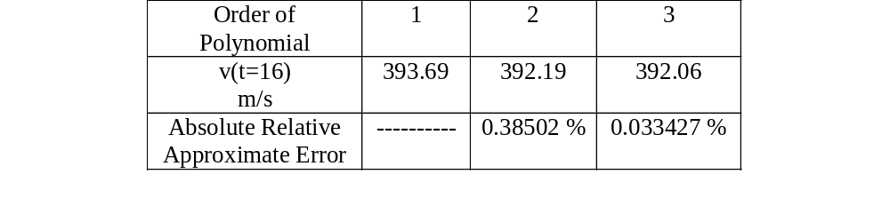






Comparison Table

Slide 23



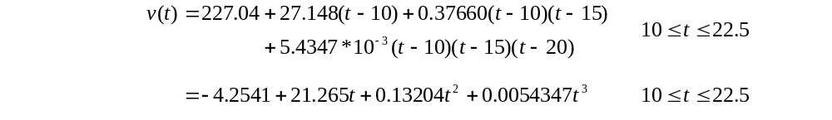

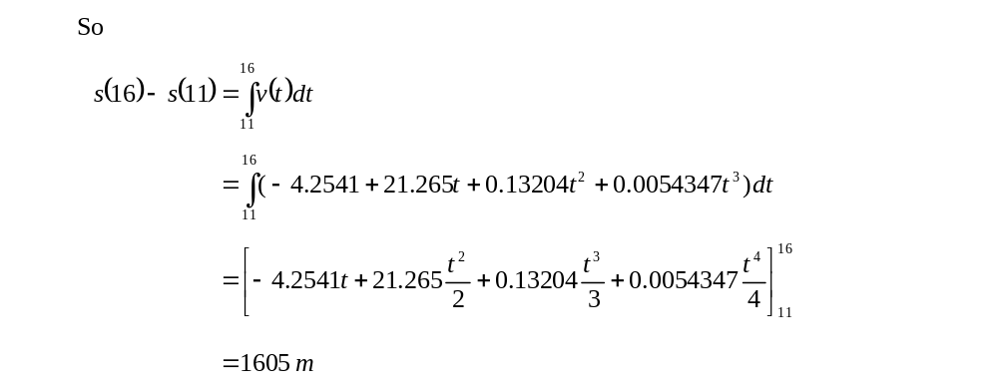


Distance from Velocity Profile
Find the distance covered by the rocket from t=11s to
t=16s ?

Slide 24


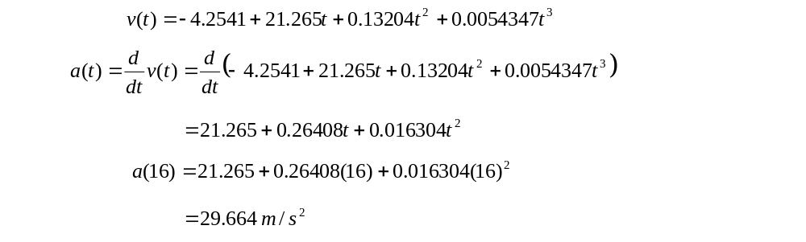

Acceleration from Velocity Profile
Find the acceleration of the rocket at t=16s given that

Slide 25
THE END

